Slide 1

Simple Calculator
Using GUI Tkinter Python
By Mohammed Ateeq

Slide 2
Summary
This calculator tutorial exercises a number of common techniques that anyone working with Tkinter will need to become familiar with, including:
Coding events that define what happens when a user interacts with a UI element
Creating containers/windows that contain Frame widgets in which UI elements can be placed
Using Tkinter’s Layout Manager to position Button widgets within a Frame widget
There are three Layout Managers available for Tkinter: pack(), place(), grid().
pack() organizes widgets in horizontal and vertical boxes that are limited to left, right, top, bottom positions. Each box is offset and relative to each other.
place() places widgets in a two-dimensional grid using x and y absolute coordinates.
grid() arranges widgets in a two-dimensional grid using row and column absolute coordinates similar to a spreadsheet.
In addition, you can use padding (padx, pady)to modify the spacing between pack() sides, place() x,y coordinates, and grid()rows and columns. For example:
Button widget functions are positioned with grid(). For example: multiply.grid(row=1, column=3,padx=1, pady=1)
The grid Layout Manager was chosen for the Calculator application because of its precision
compared to other layout methods. After all, a calculator needs to be precise.

Slide 3
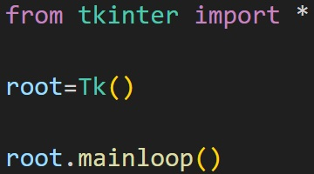
Main Window/Container
UI elements require a container/window in which widget are placed.

Slide 4
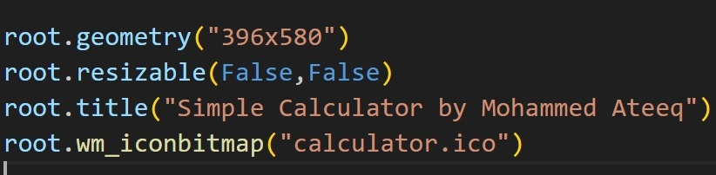
Window size, title, icon widget
Geometry method that defines the root window size: “width x height”:
Prevent root window from been resized:
for title as appeared in top
icon for window

Slide 5
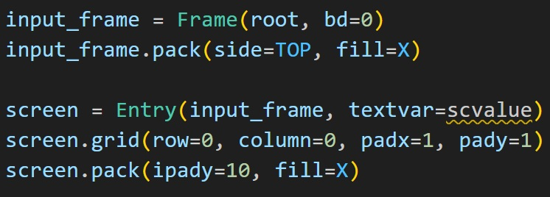
Screen
Entry widget used inside the Frame widget for the screen.

Slide 6
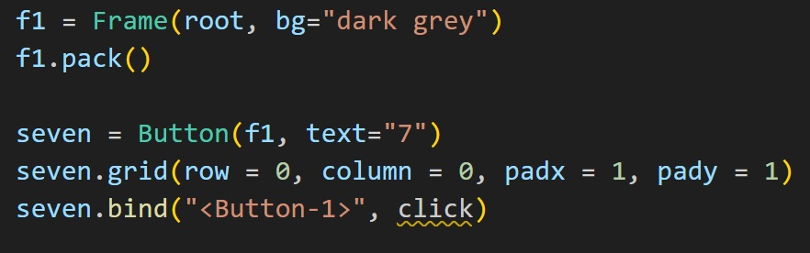
Buttons
Button widget functions are positioned inside frame with grid() Layout and bind with click function.

Slide 7
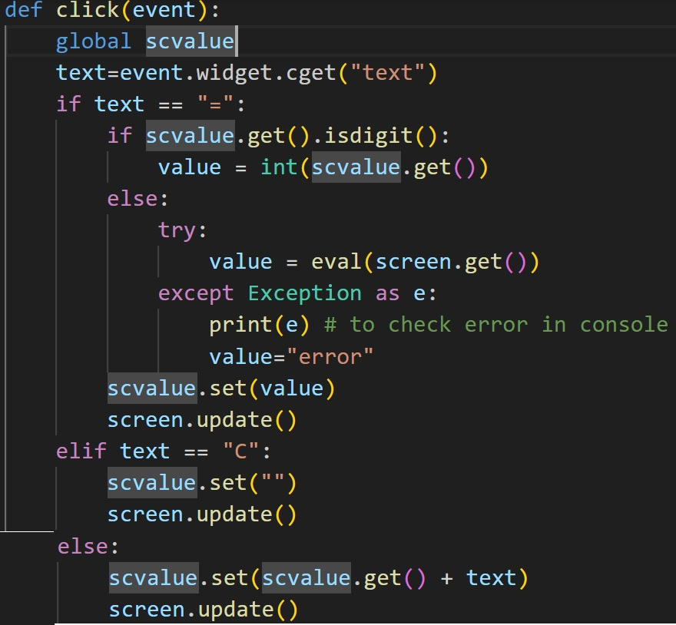
Function
First we bind the button to click event
Creating global variable
Capture the Value of buttons
Check the equal button whether scvalue is digit or any expression and set accordingly.
Also we handling the by using try and except function.
Then we set the cancel “C” button value to empty whenever it is press.
Finally we set the scvalue + text and update the screen.

Slide 8
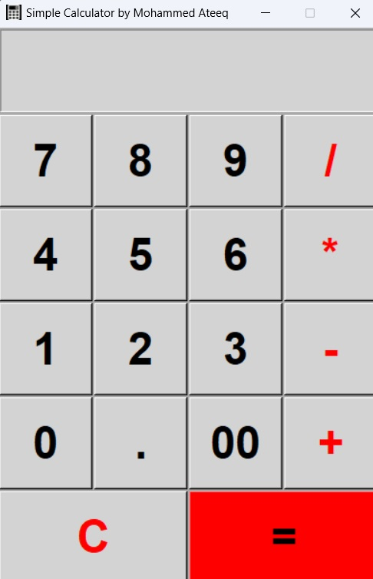
Final Output of Calculator

